Slide 1
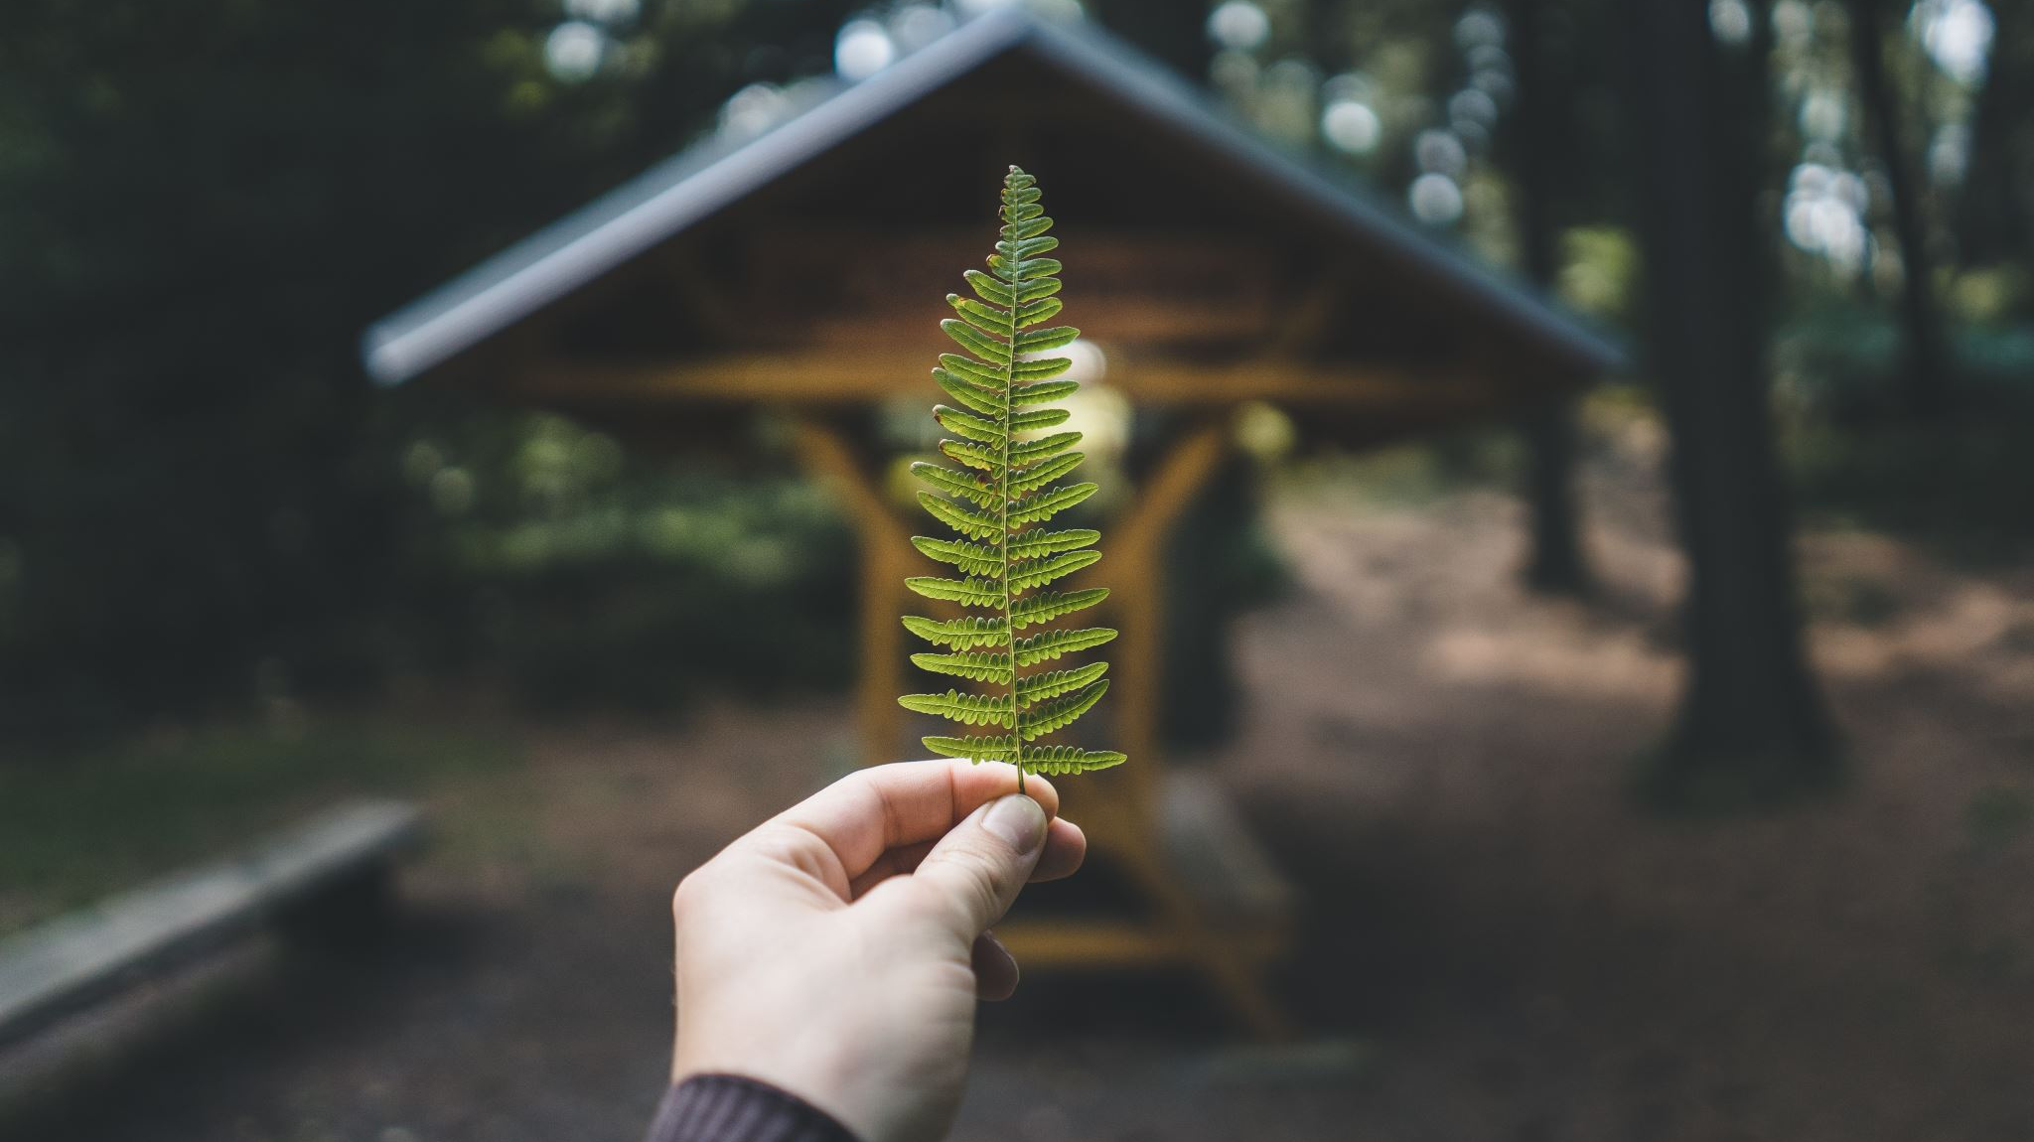
Enhanced Botanical Learning Platform
A Redesign of the Plantzzz App
Name: Marie Akiyama
Student ID: 1157245

Slide 2
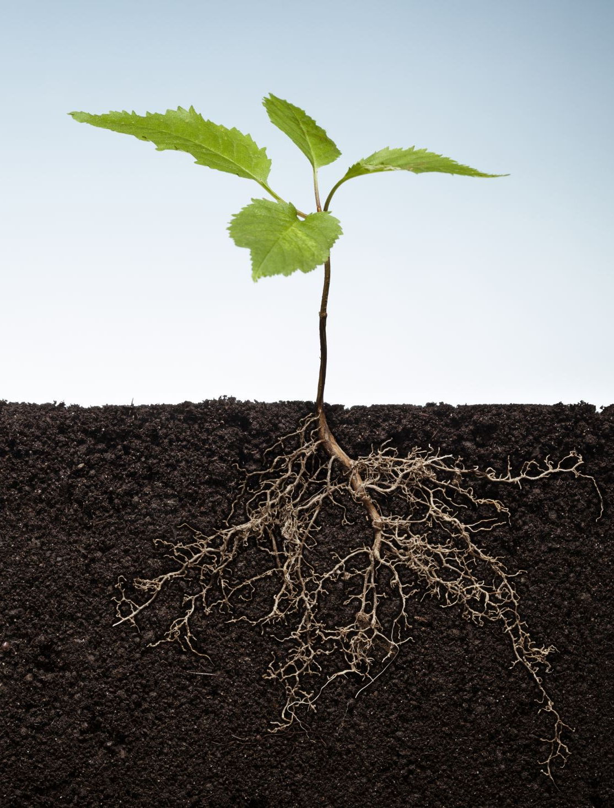
Introduction
Project Sponsor: Lincoln University
Problem Definition: Need for an updated plant identification Quiz app for LASC 206 and LASC 211
Brief: Enhance user engagement, improve content management, and ensure smooth backend performance.

Slide 3

Background
Current Situation: Existing Plantzzz app built on an outdated platform
Limitations: outdated technology and lack of interactivity
Objective: Rebuild the app from scratch with improved features

Slide 4

Goals and Objectives
Primary Goals:
Enhance user engagement
Simplify Quiz content
Ensure smooth performance
Success Criteria:
Positive user feedback
Improved student learning experience
Reliable backend system

Slide 5
Method
Approach: Analysis of the existing app
Development of new interactive features
Extensive testing
Techniques and Tools: JavaScript, React, Node.js, JSON
User feedback and Agile methodology

Slide 6
User Interface
login page,
Topic selection
Quiz page
Scorecard

Slide 7

Demo for plantzzz App
Show user authentication Login process
Show how results are displayed in Scorecard
Logout and show how system hints previous score and login details
Navigate through the learning topic selection page
Take a plant quiz and demonstrate the interactive elements

Slide 8
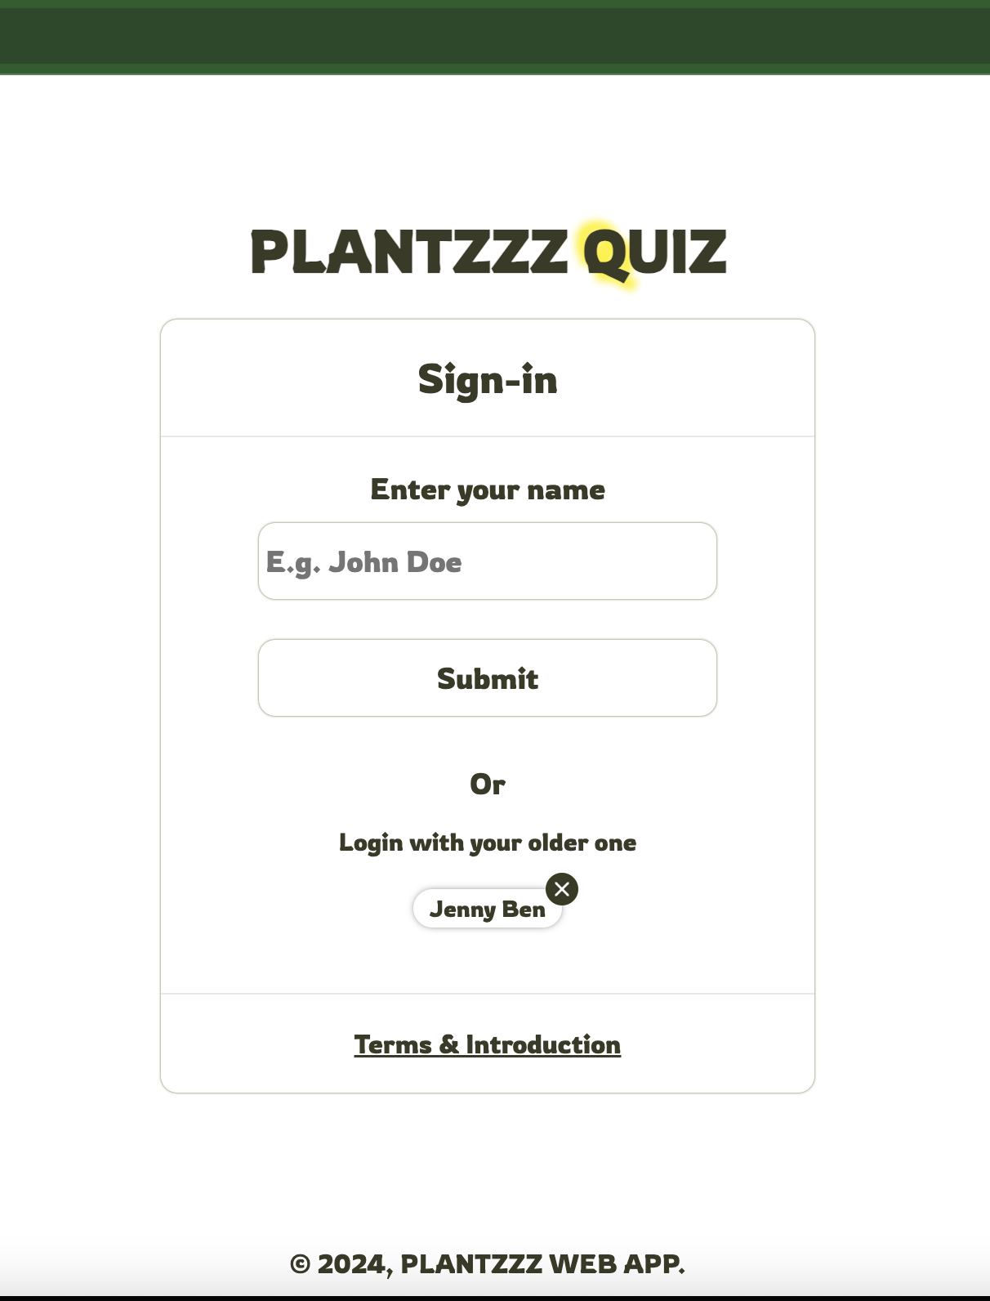
User Authentation
Walkthrough of the login page
Show Error Message
Term and Introduction

Slide 9
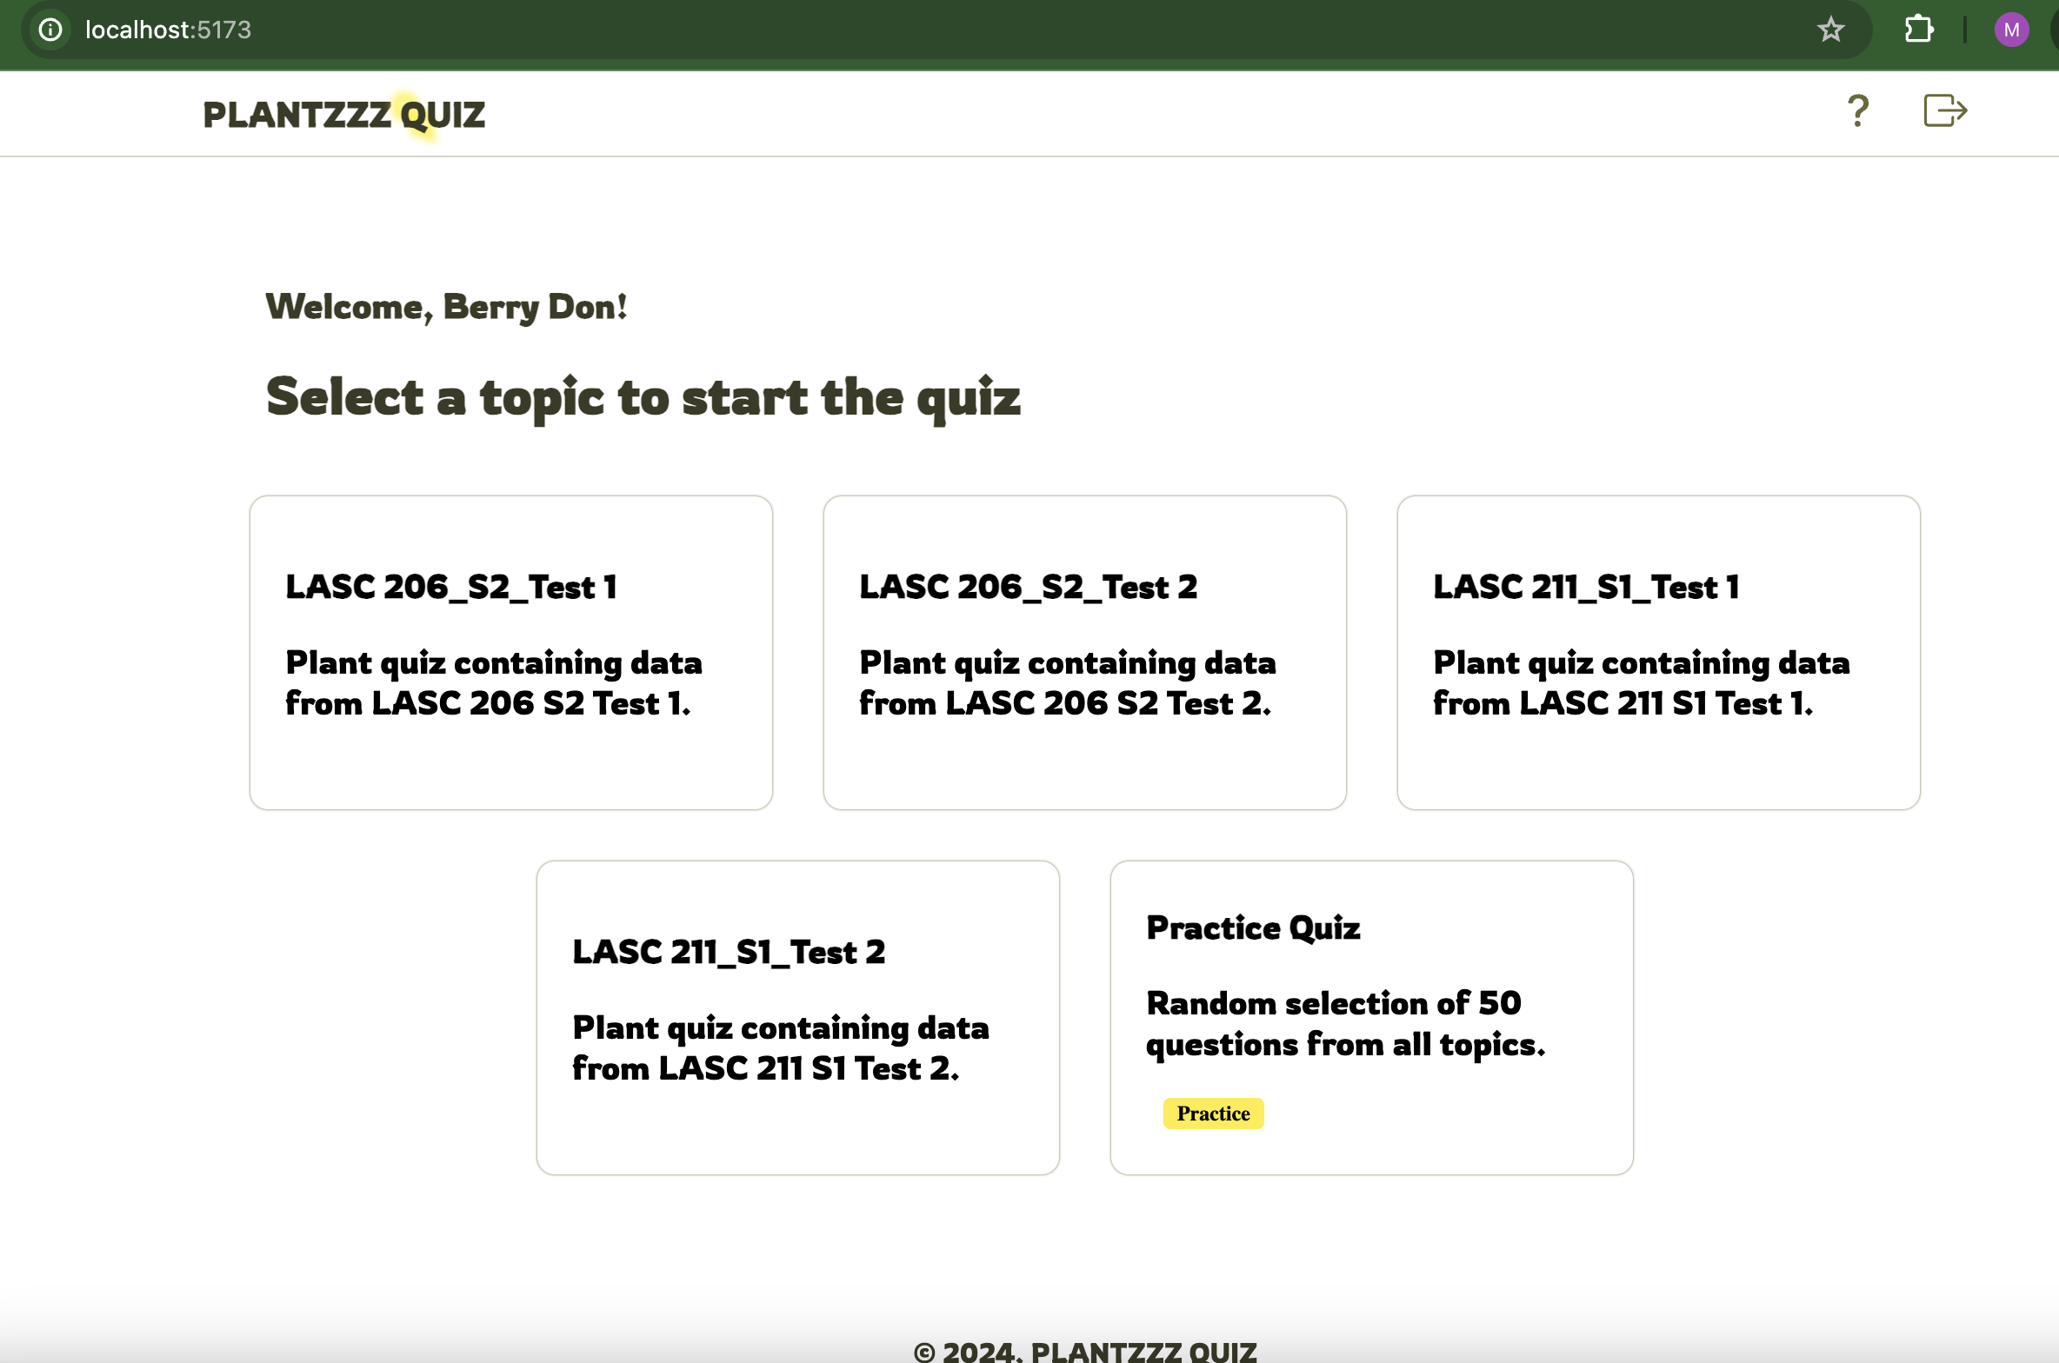
Topic Selection
Learning topics
Practice Quiz
Info

Slide 10
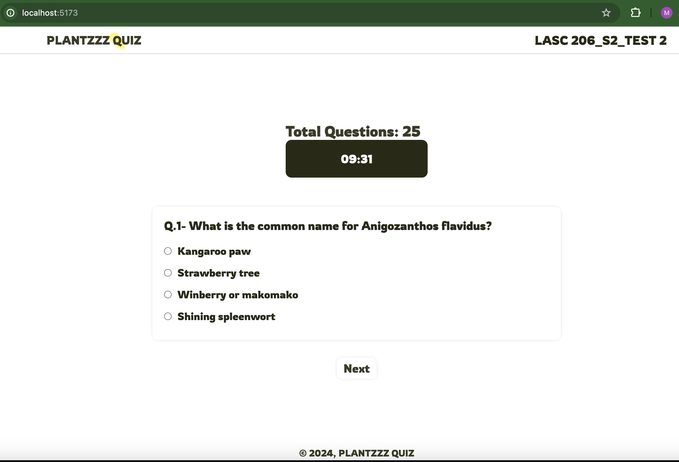

Taking a Quiz
Questions qty
Select ‘Next”
10 minutes Timer

Slide 11
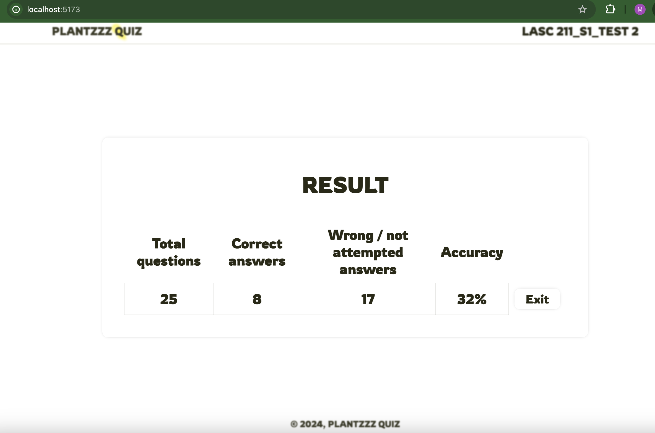

Scorecard
Displaying user results, scores, and feedback.
Log out

Slide 12

Conclusion and Reflections
Project Success: Meet all requirements
Future Development: Potential features to implement, such as immediate answer feedback and an admin interface.
Skills Gained: Proficiency in JavaScript, React, Node.js, JSON.
Enhanced problem-solving and user-friendly design skills.

Slide 13

Q&A

